Slide 1

Pc interview
Coey sherwin

Slide 2



Agenda
this is a PowerPoint about an interview conducted about people and their preference about pcs.
I did research about prices of pcs and the specs and cosmetics.
Interview Description: Chad Charles Mathews.
Budget,performance,aesthetic,design.
Because the pc needs to not break the look of there room/storage place, and it needs to handle for the persons work gaming and other entertainment they may want to experience with it.

Slide 3
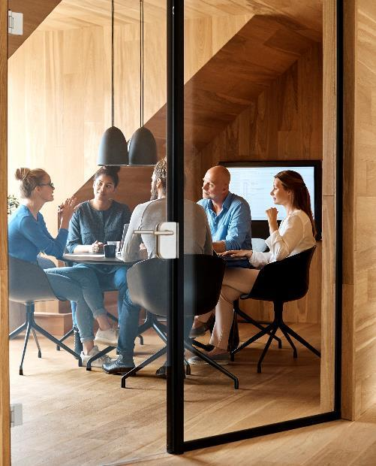




Inter viewing a person : Chad

Slide 4

Getting Started
I got started by researching pc parts on a site and compiling prices and specs

Slide 5
Pc interviewing
I interviewed Chad these three questions: ? [answers] : at least 16gbs and I don’t know
How strong of a ram and CPU do you want strong enough to play high
how much budget would you like? end games. 2. 1200 max
What would you use your new pc for? 3. gaming

Slide 6
Selection
College Student - Budget PC Build which fits the range even though prebuilt the specs were hard to best when trying to find good yet cheap parts

Slide 7
Justification
I chose this obviously because of the budget it has reasonable specs it has a good CPU but since the price it is drawn back a bit but in all they were happy with the results

Slide 8

Summary
To sum it up Chad was happy with the specs of the pc and it was good finding this pc .

Slide 9


Thank You
Thanks for viewing this presentation from Coey

Slide 10




Team
Name
Name
Name
Name
Title
Title
Title
Title

Slide 11
Chart

Slide 12
Table
 | Category 1 | Category 2 | Category 3 | Category 4
Item 1 | 4.5 | 2.3 | 1.7 | 5
Item 2 | 3.2 | 5.1 | 4.4 | 3
Item 3 | 2.1 | 1.7 | 2.5 | 2.8
Item 4 | 4.5 | 2.2 | 1.7 | 7

Slide 13

The way to get started is to quit talking and begin doing.
Walt Disney

Slide 14
Timeline
Title
To start a presentation, go to the Slide Show tab, and select From Beginning.
Title
To display Presenter view, in Slide Show view, on the control bar at the bottom left select the three dots, and then Show Presenter View.
Title
During your presentation, the speaker notes are visible on your monitor, but aren't visible to the audience.
Title
Title
If you don’t see the Notes pane or it is completely minimized, click Notes on the task bar across the bottom of the PowerPoint window.
The Notes pane is a box that appears below each slide. Tap it to add notes.

Slide 15
Content
Subtitle
Subtitle
Add text, images, art, and videos.
Add transitions, animations, and motion.
Save to OneDrive, to get to your presentations from your computer, tablet, or phone.
Open the Design Ideas pane for instant slide makeovers.
When we have design ideas, we’ll show them to you right there.

Slide 16
Content 2
Subtitle
subtitle
subtitle
Add text, images, art, and videos.
Add transitions, animations, and motion.
Save to OneDrive, to get to your presentations from your computer, tablet, or phone.
Open the Design Ideas pane for instant slide makeovers.
When we have design ideas, we’ll show them to you right there.
Add text, images, art, and videos.
Add transitions, animations, and motion.
Save to OneDrive, to get to your presentations from your computer, tablet, or phone.
Open the Design Ideas pane for instant slide makeovers.
When we have design ideas, we’ll show them to you right there.
Add text, images, art, and videos.
Add transitions, animations, and motion.
Save to OneDrive, to get to your presentations from your computer, tablet, or phone.
Open the Design Ideas pane for instant slide makeovers.
When we have design ideas, we’ll show them to you right there.

